Slide 1
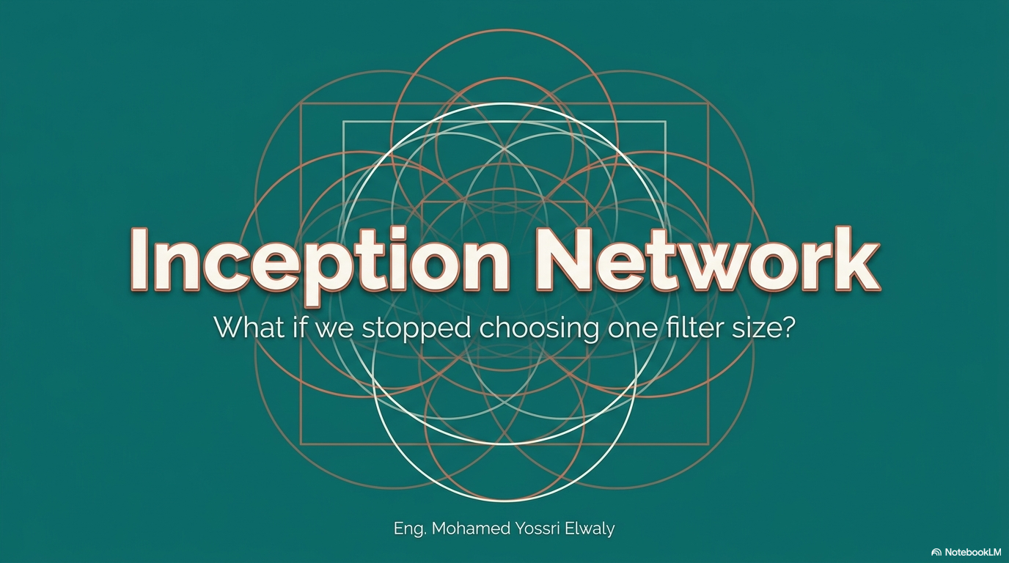

Slide 2
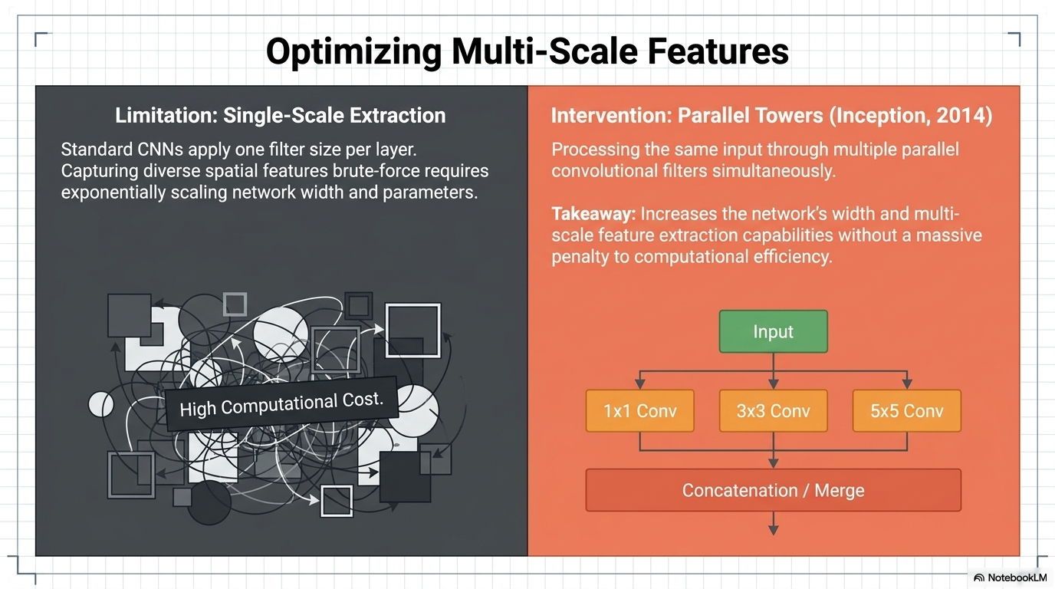

Slide 3
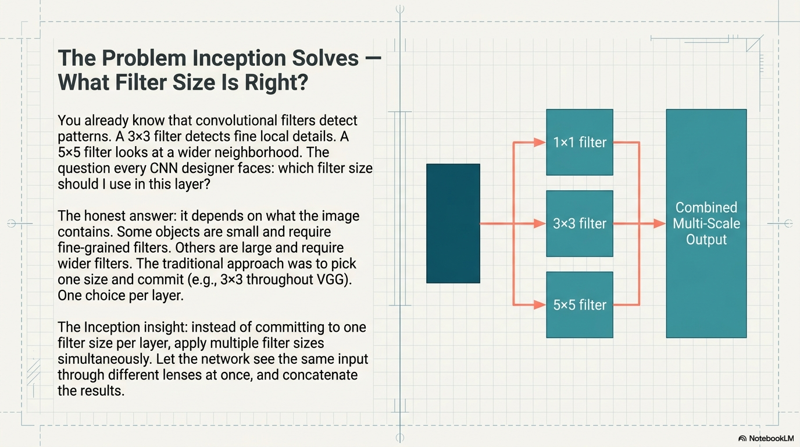
Eng. Mohamed Yossri Elwaly

Slide 4
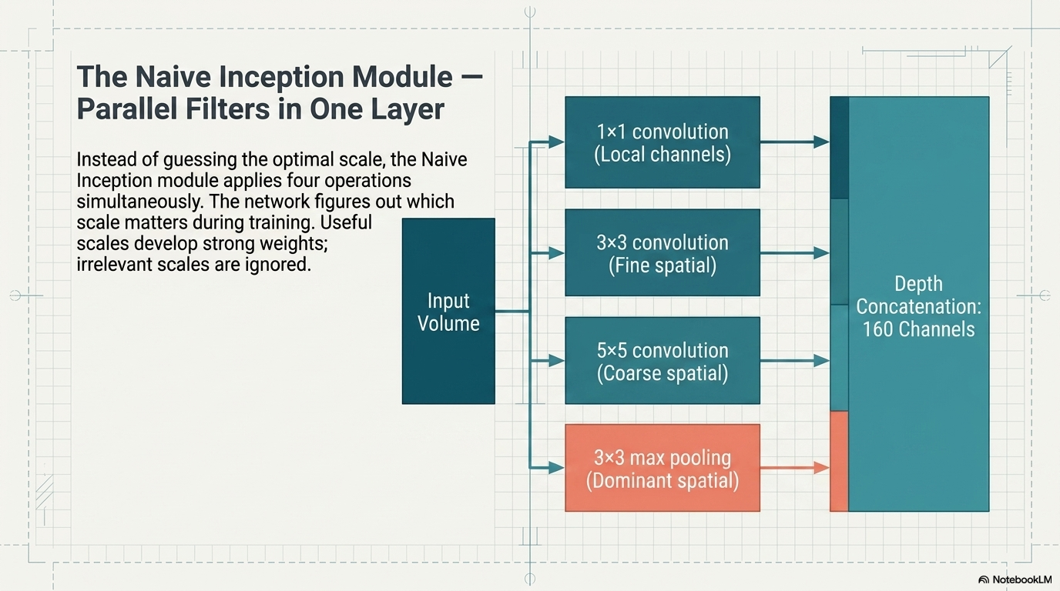
Eng. Mohamed Yossri Elwaly

Slide 5
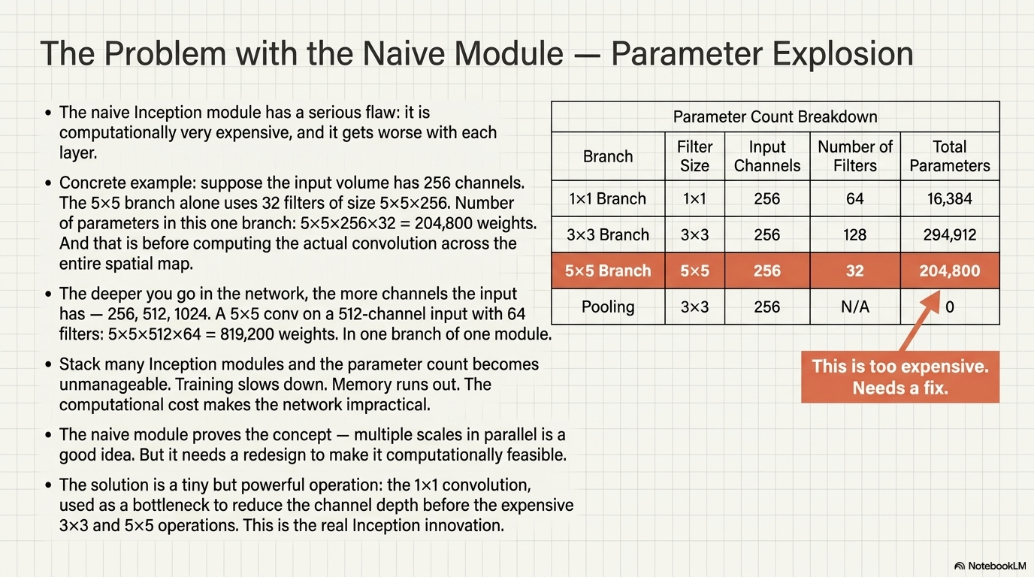

Slide 6
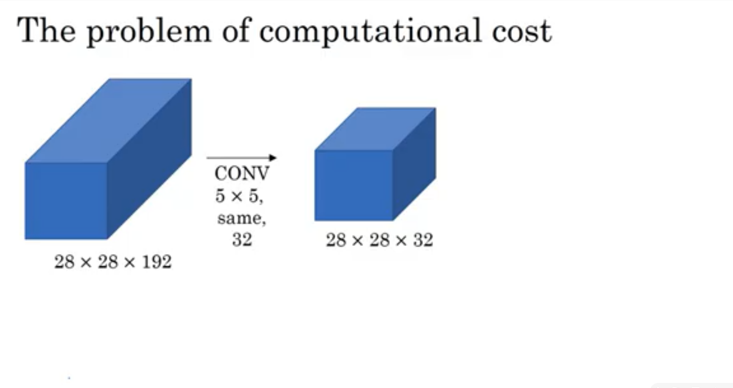

Slide 7
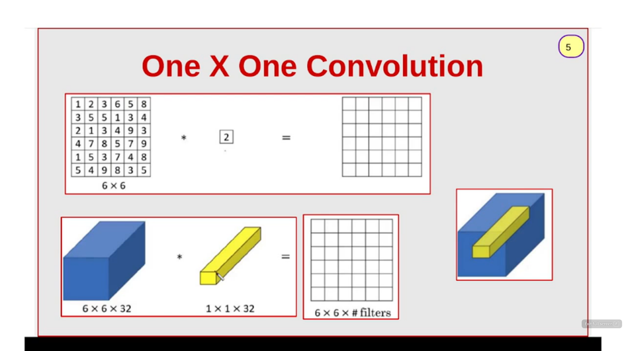

Slide 8
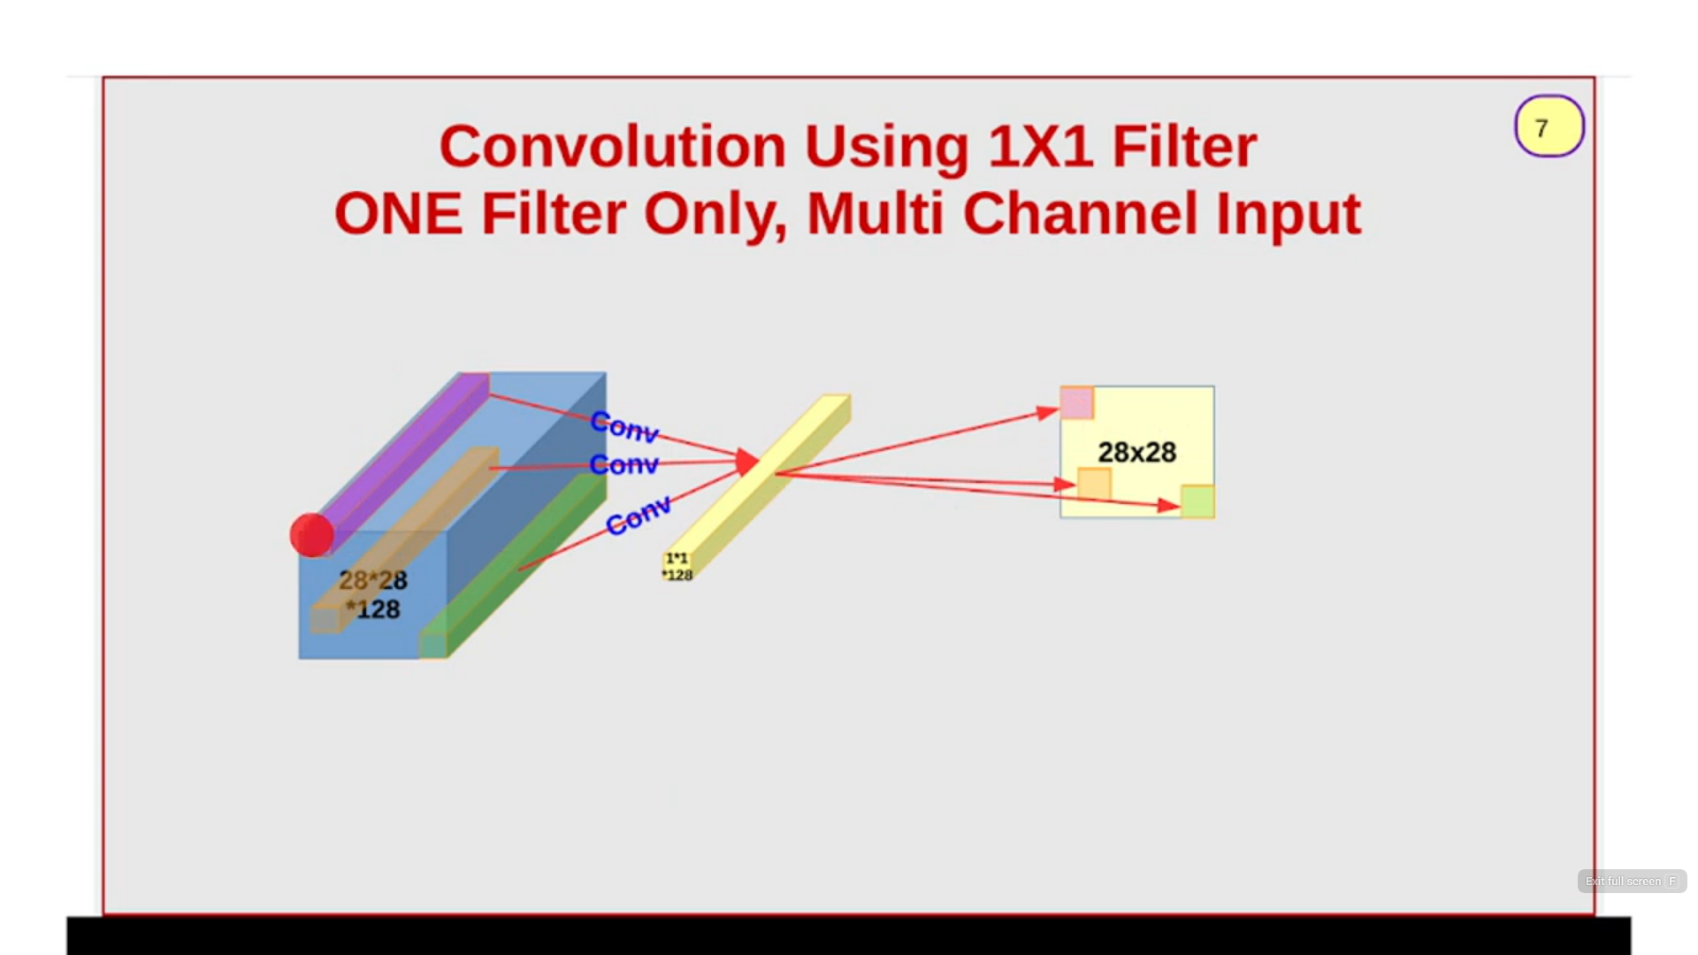

Slide 9
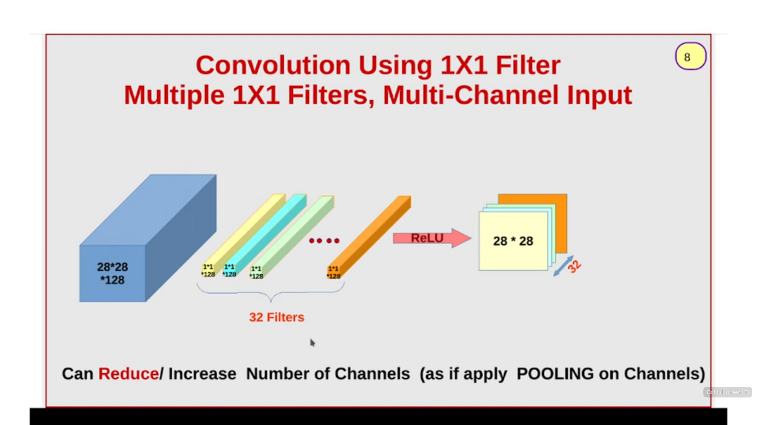

Slide 10
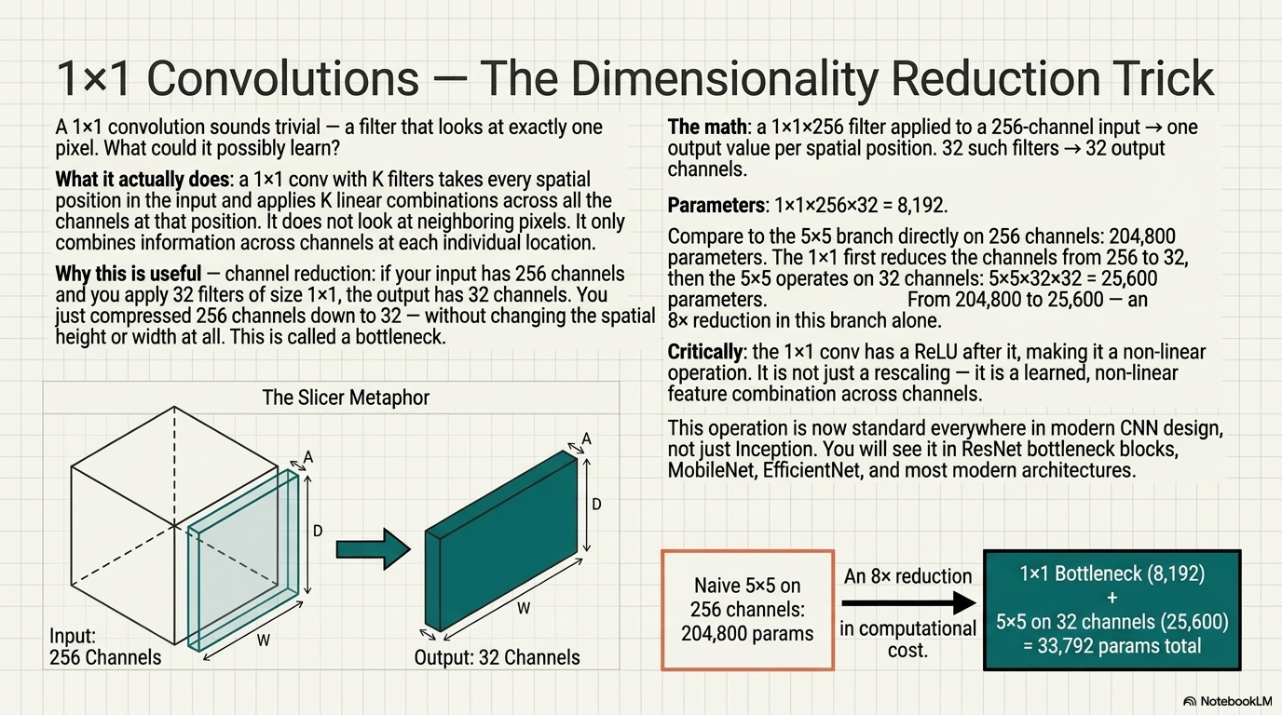
Eng. Mohamed Yossri Elwaly

Slide 11
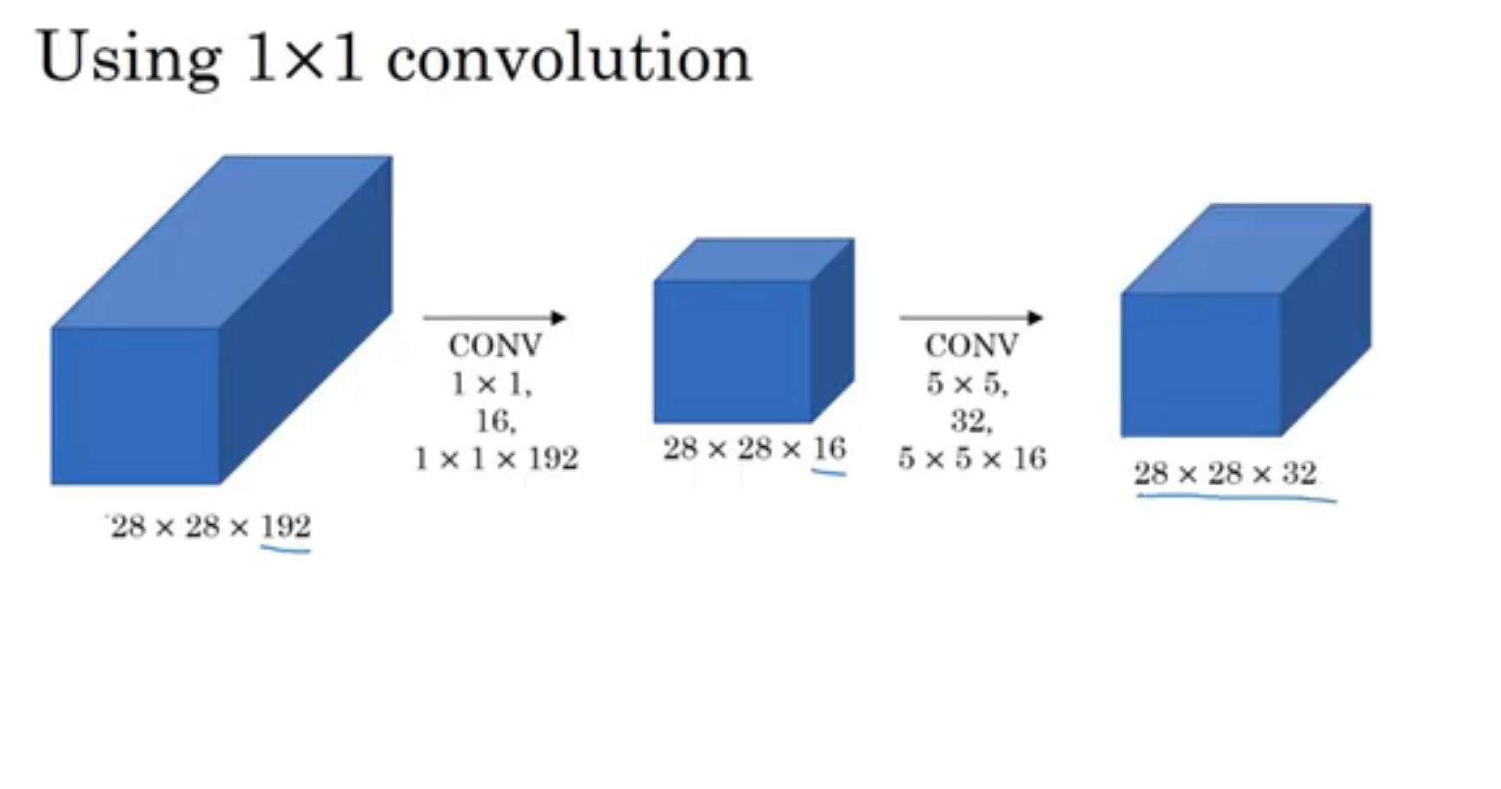

Slide 12
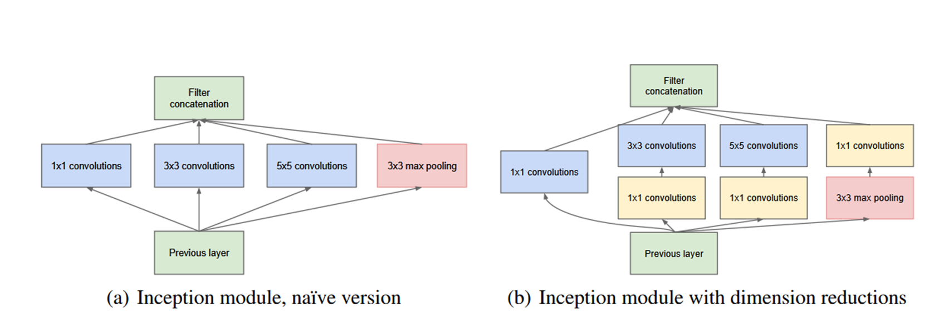
Inception module, Naïve vs with dimension reductions
Evolution of Segmentation Models

Slide 13
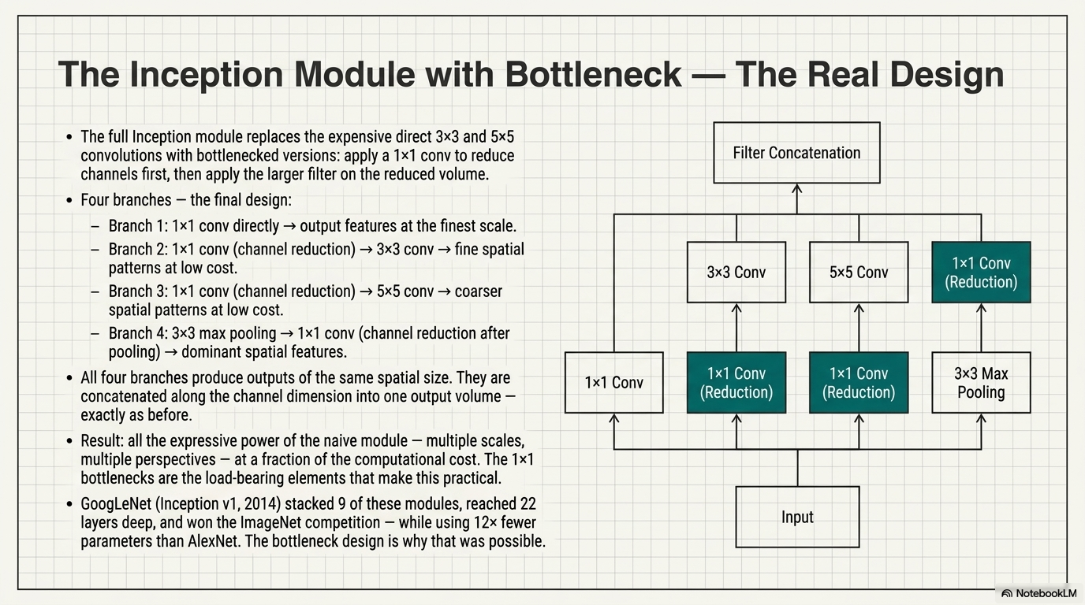
Eng. Mohamed Yossri Elwaly

Slide 14
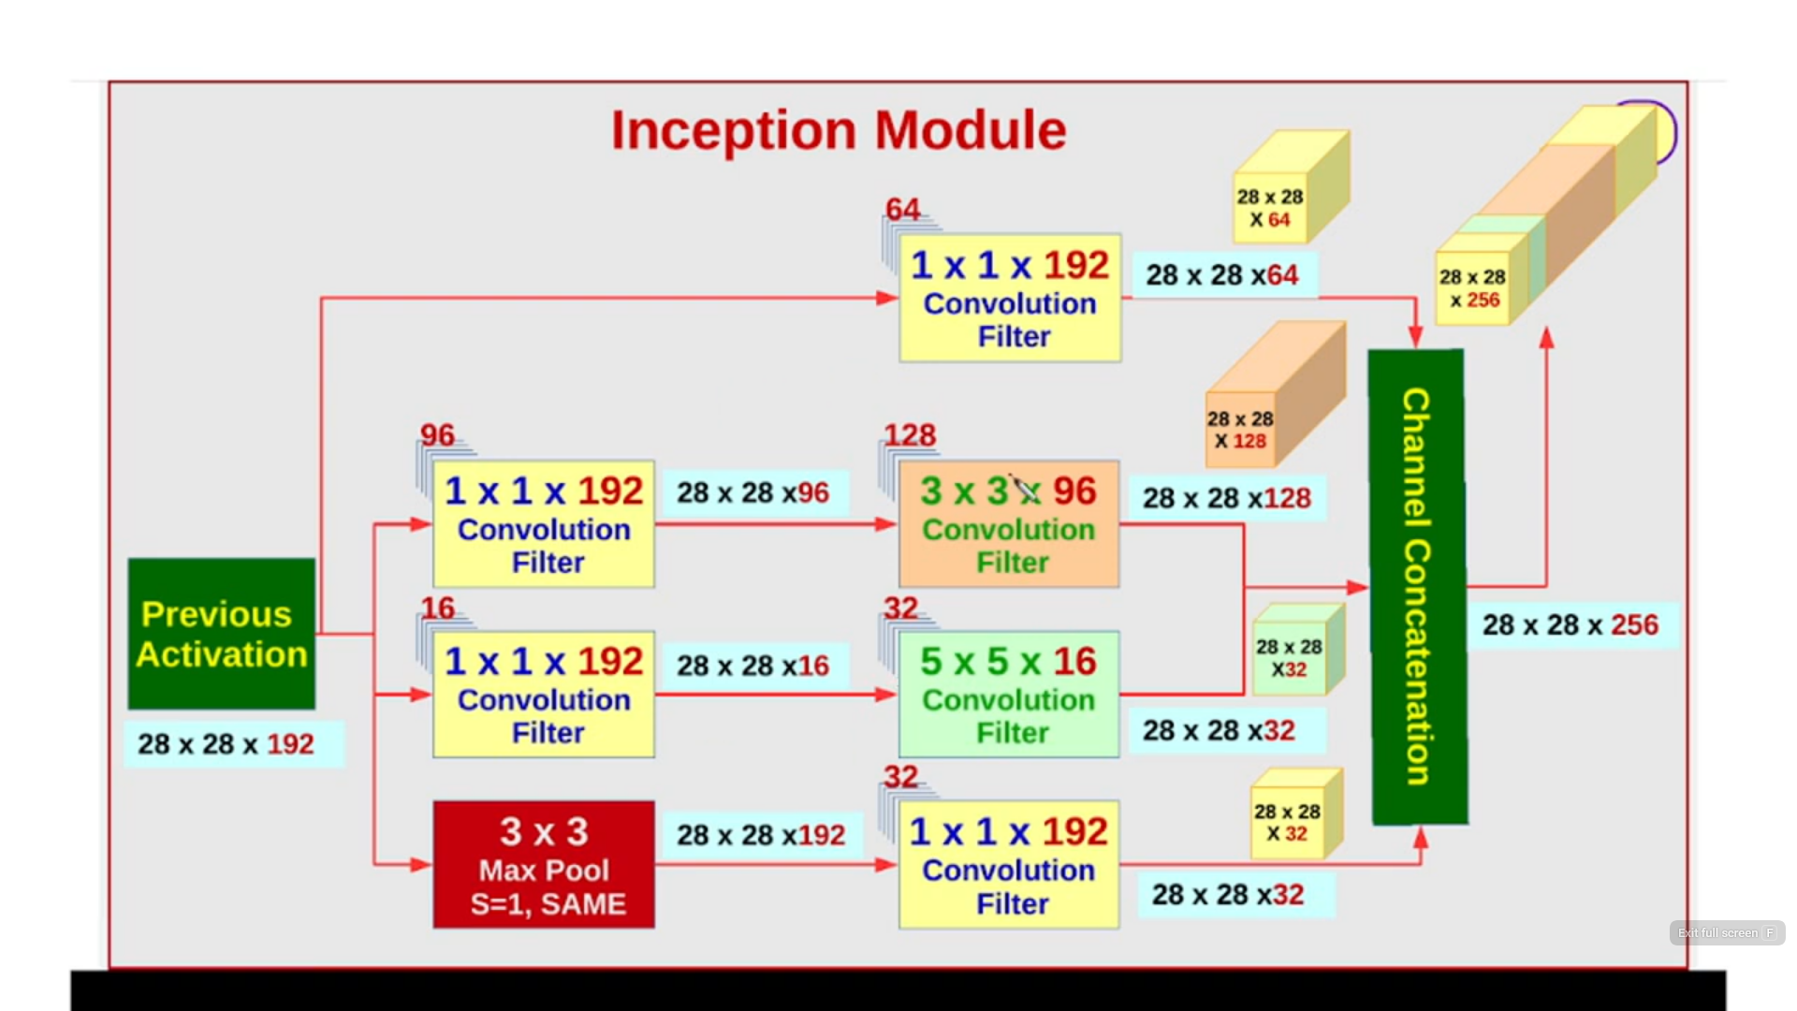

Slide 15
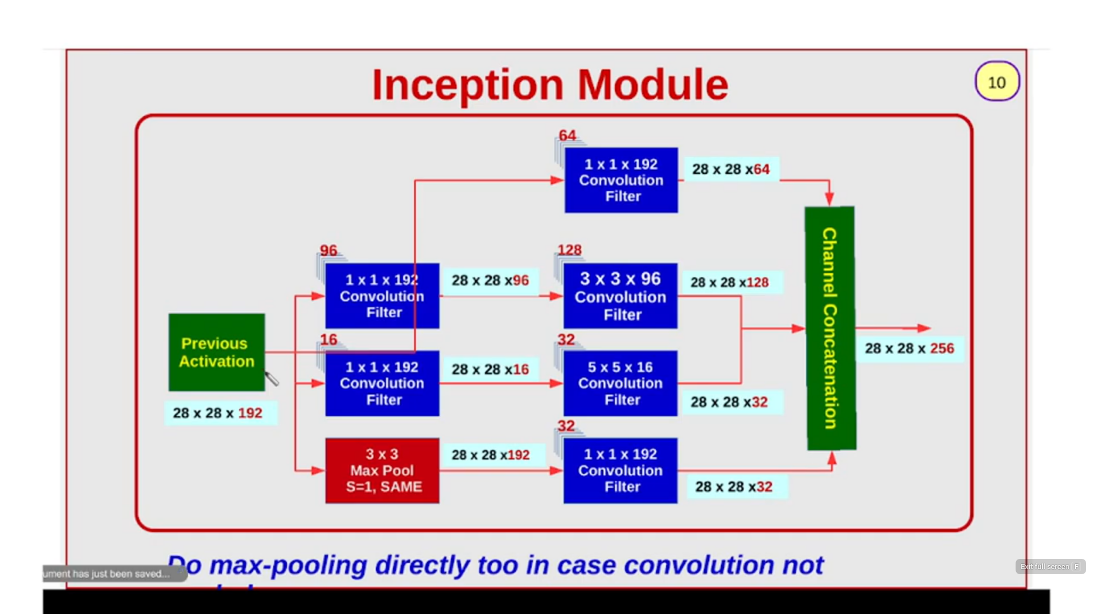

Slide 16

GoogLeNet
Going Deeper with Inception Blooks
Eng. Mohamed Yossri Elwaly

Slide 17
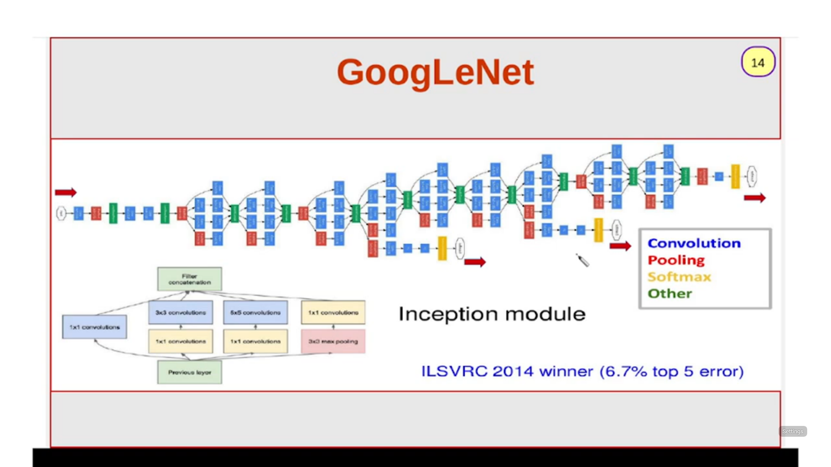

Slide 18
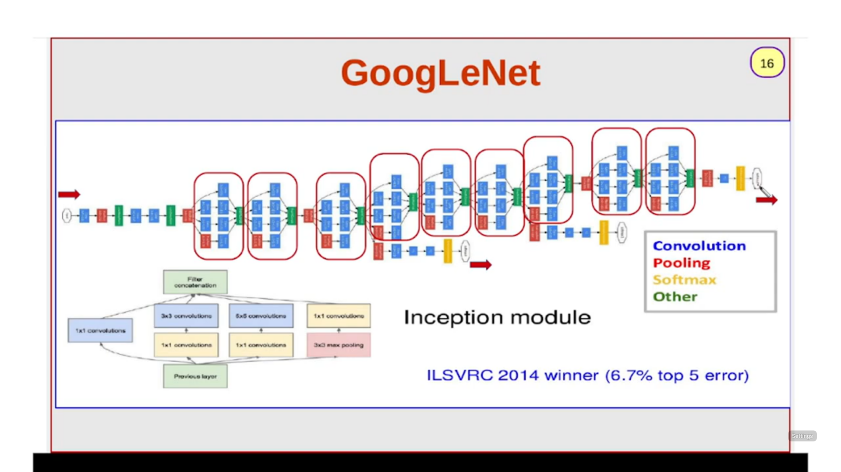

Slide 19
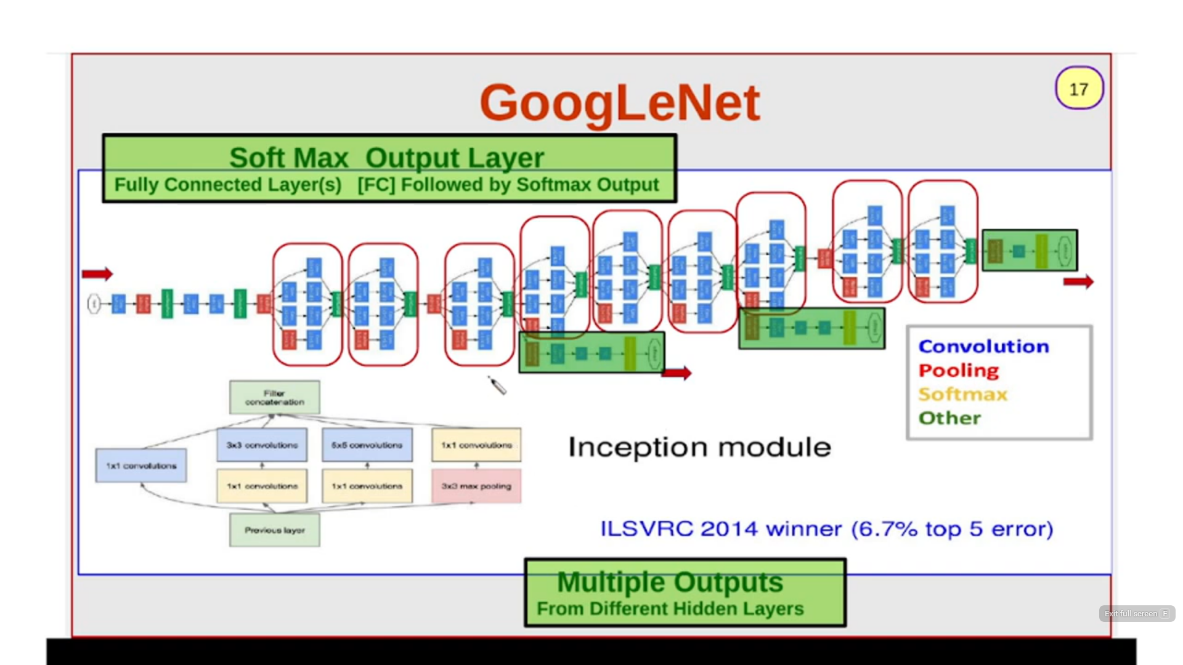

Slide 20
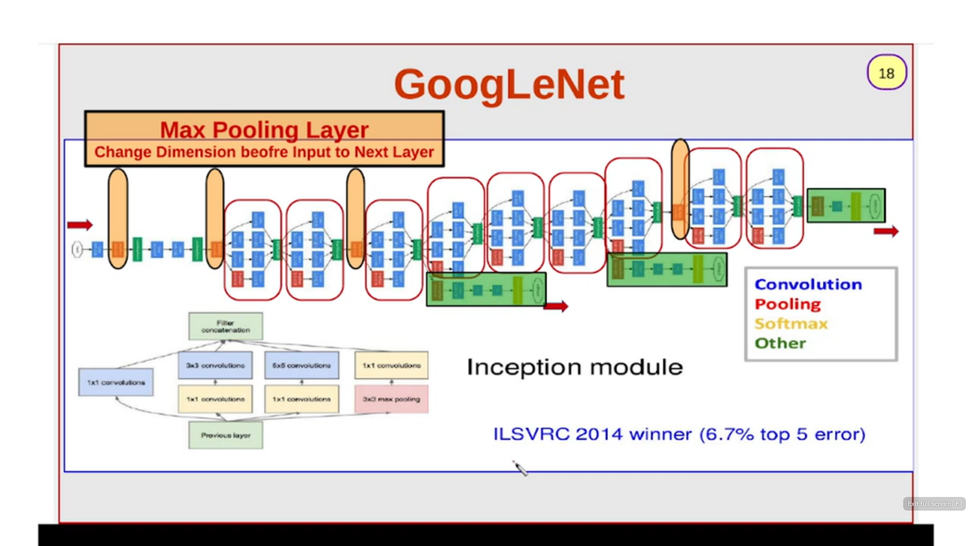

Slide 21
Evolution of the Inception Architecture
Standard vs. Factorized Modules : Architectural Refinements in Inception-v2/v3
Eng. Mohamed Yossri Elwaly

Slide 22
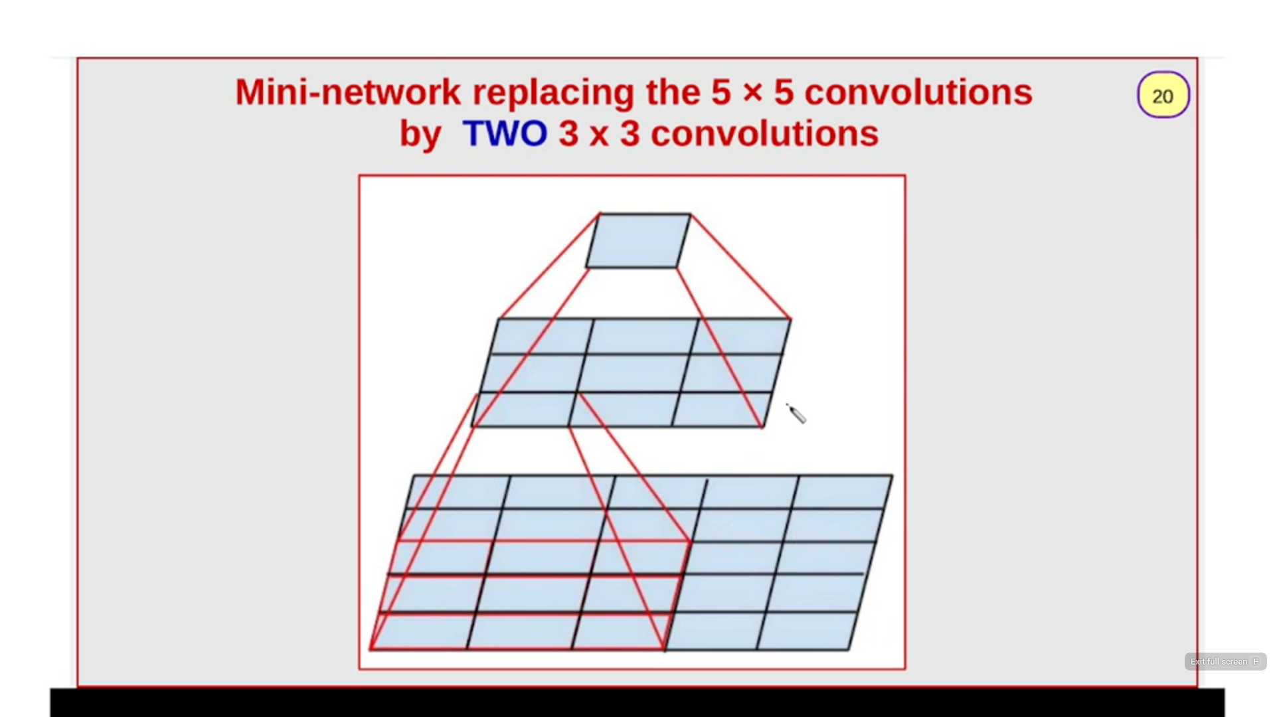

Slide 23
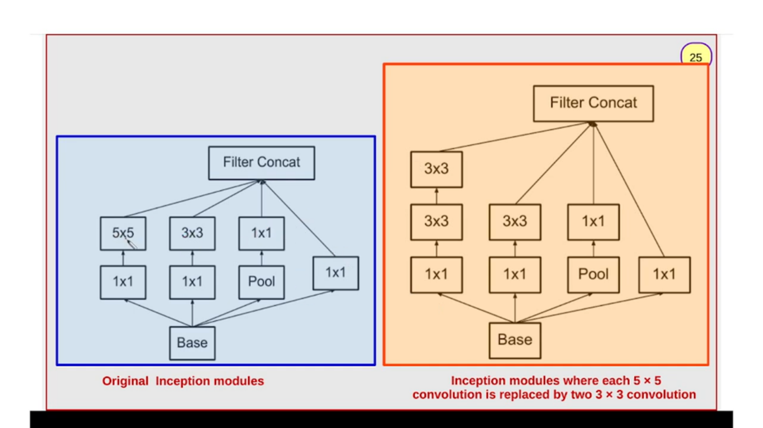

Slide 24
Questions & Discussion
Eng. Mohamed Yossri Elwaly

